Slide 1
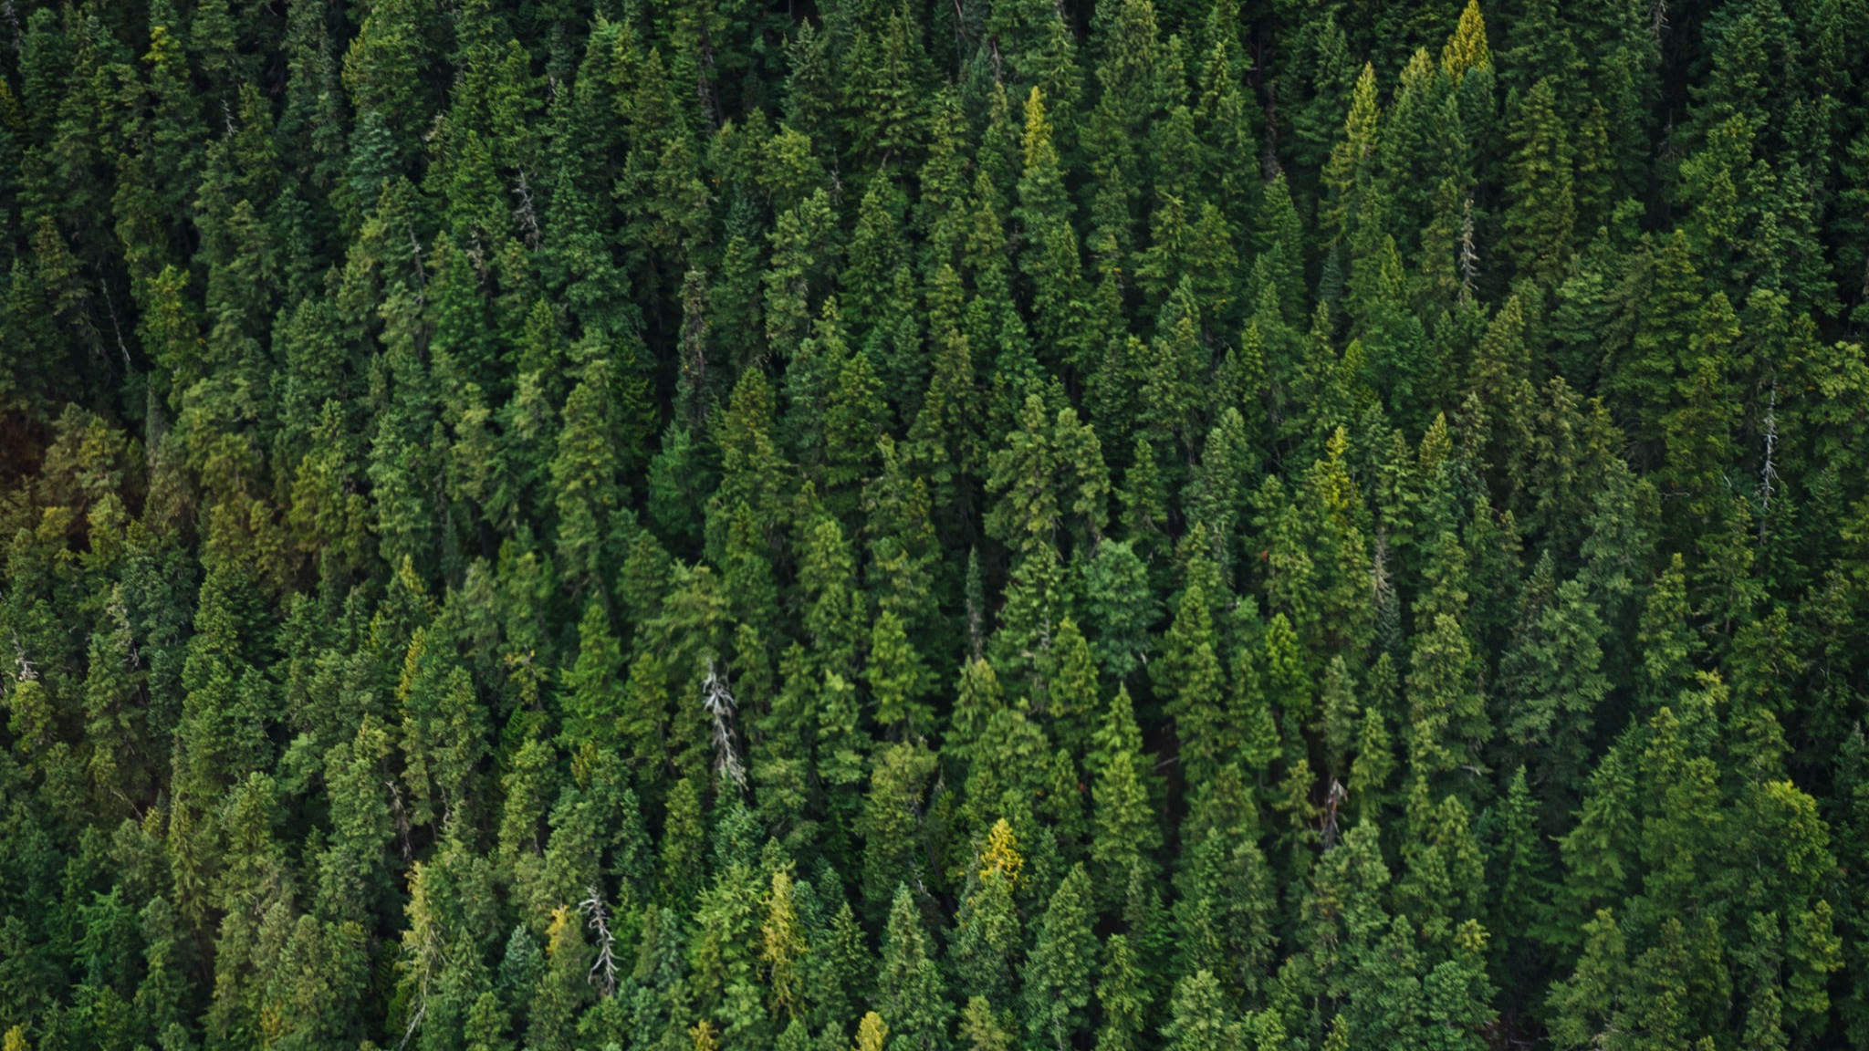
Real-Time Fire and Smoke
Detection using YOLOv8
Members: Hoang Tu Huynh, Thoa Nguyen, Sean Butler, Daniyal Dianati, and Keita Katsumi
December 4, 2025

Slide 2
Sections
Section
Q1
Introduction / Summary
Q2
Problem
Q3
Goal
Q4
Pros and Cons

Slide 3
Sections
Section
Q5
Training
Q6
Results
Q7
Conclusion
Q8
Questions

Slide 4

Introduction
Section
Section
12
In fire prone areas which typically have draw vegetation, high heat weather and low humidity can cause a lot of damage
This can reveal itself as
a loss of crops
extreme change of environment/ ecosystem
There are also places with plenty of vegetation like bushes and trees compact together
These fires cause a lot of devastation and cost a lot of money
Cost of fighting the fire
Cost of burned buildings
Disruption to a region's ecosystem
death
There have been systems over time that work on preventive countermeasures, tracking and other methods. We are looking at the a paper that shows that we may be able to take action before the fire has happened

Slide 5
What’s the Problem?
Section
Section
12
We are detecting Fires but why as we have other methods
Satelite
Human Observable
Infrared Camera
Looking at satellite data takes too long
Download and Scan time can still take too long to react to a fire in action
Limited view
Human Observable
Limited view
High cost
Time consuming
Infrared
Scattering issues
If near water it will create vapor and that will get detected and just the water
Wind that may carry high heat around making it hard to determine the location of the fire

Slide 6
What are the Goals?
Section
Section
12
Build and train a YOLOv8-based model capable of detecting fire in images and video streams.
Measure performance using metrics such as precision, recall, mAP, and inference speed.
Analyze the model’s behavior across different fire scenarios (size, lighting, background).
Assess whether YOLOv8 is suitable for real-time fire detection applications.

Slide 7
What is the Pros and Cons of using YOLO?
Section
Section
12
Pros:
Real-time performance — fast inference, suitable for early fire alerts.
High accuracy on small/irregular objects — useful for detecting flames.
Lightweight variants available — deployable on edge devices (CCTV, drones).
Easy training pipeline — Ultralytics provides simple tools and good documentation
Cons:
Requires diverse fire datasets to avoid overfitting and false alarms.
Prone to false positives from lights, reflections, and orange/red objects.
Harder to detect early-stage or low-visibility fire (small flames, smoke).
Heavier models need GPUs , larger YOLO variants are computationally demanding.

Slide 8
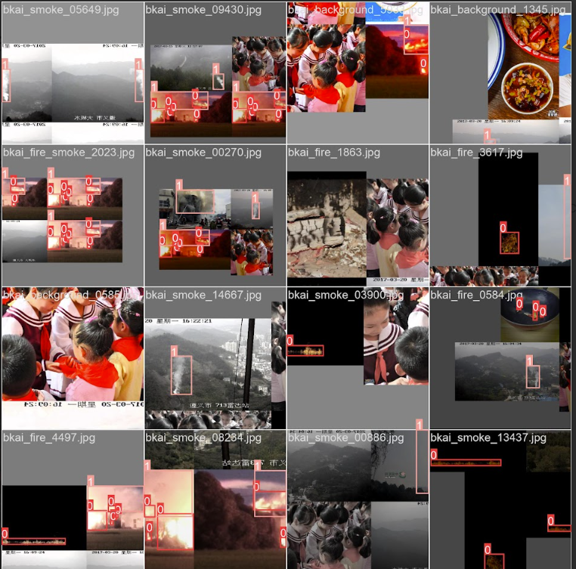
Dataset
Section
Section
12
Dataset Details
Datasets from RoboFlow with a focus on fires
Fire Detection Training Set
4000 images
1483 fire images
1533 smoke images
Preprocessing:
Raw Data: Collection of aerial and ground-level images containing instances of 'Fire' and 'Smoke'.
Annotation Format: Data was supplied/converted into the standard YOLO format (.txt files), where each line contains: [class_id] [x_center] [y_center] [width] [height].
Normalization: All bounding box coordinates are normalized (0 to 1) relative to the image dimensions, ensuring scale independence.
Image Consistency: All images were resized to the training dimension (256x256 pixels) to standardize input size, improving batch processing efficiency.

Slide 9
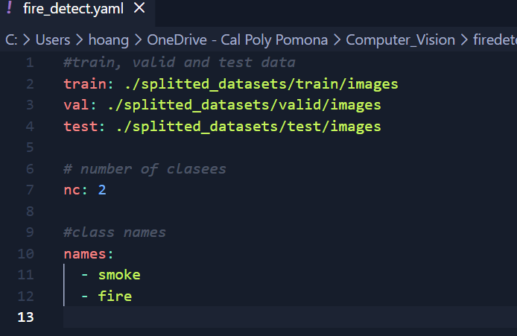
Splitting Strategy
Section
Section
12
A statistically robust division ensures accurate validation and final testing of performance on unseen data.
Splitting Ratio: The dataset was divided into three sets:
Training Set (80%): Used for model optimization and weight updates.
Validation Set (10%): Used to tune hyperparameters and monitor for overfitting during training.
Test Set (10%): Held back completely until final evaluation to provide an unbiased measure of the model's generalization capability.
Randomized Split: The split was performed randomly to ensure an even distribution of the 'Fire' and 'Smoke' classes across all three partitions, maintaining class balance.
Configuration: The final split configuration was defined in the project's fire_detect.yaml file, pointing YOLOv8 to the correct image and annotation paths.

Slide 10
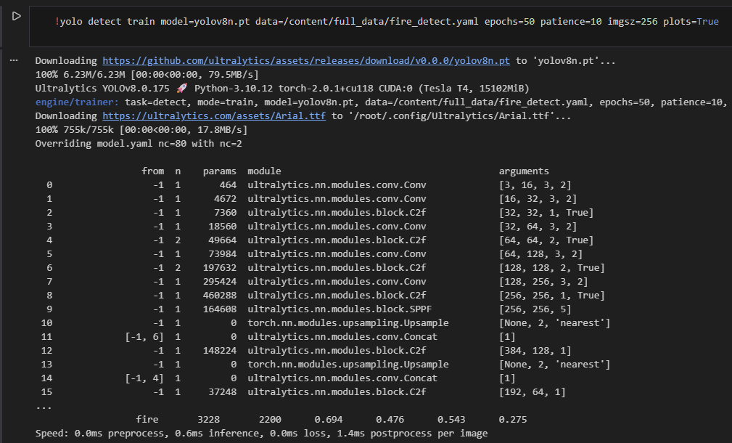
YOLOv8 Architecture
Section
Section
12
Model Specs (YOLOv8n)
Model: yolov8n.pt (Nano)
Input Size: 256 x 256 pixels
Layers: 225
Parameters: 3,011,238
Gradients: 3,011,222
Hardware
Nvidia Tesla T4
Training Hyperparams
Optimizer: SGD (Stochastic Gradient Descent)
Learning Rate: 0.01
Momentum: 0.9
Batch Size: 16
Epochs: 50 (Patience: 10)

Slide 11

YOLOv8 Results
Section
Section
12
View Yolo V8 in action in video playback

Slide 12
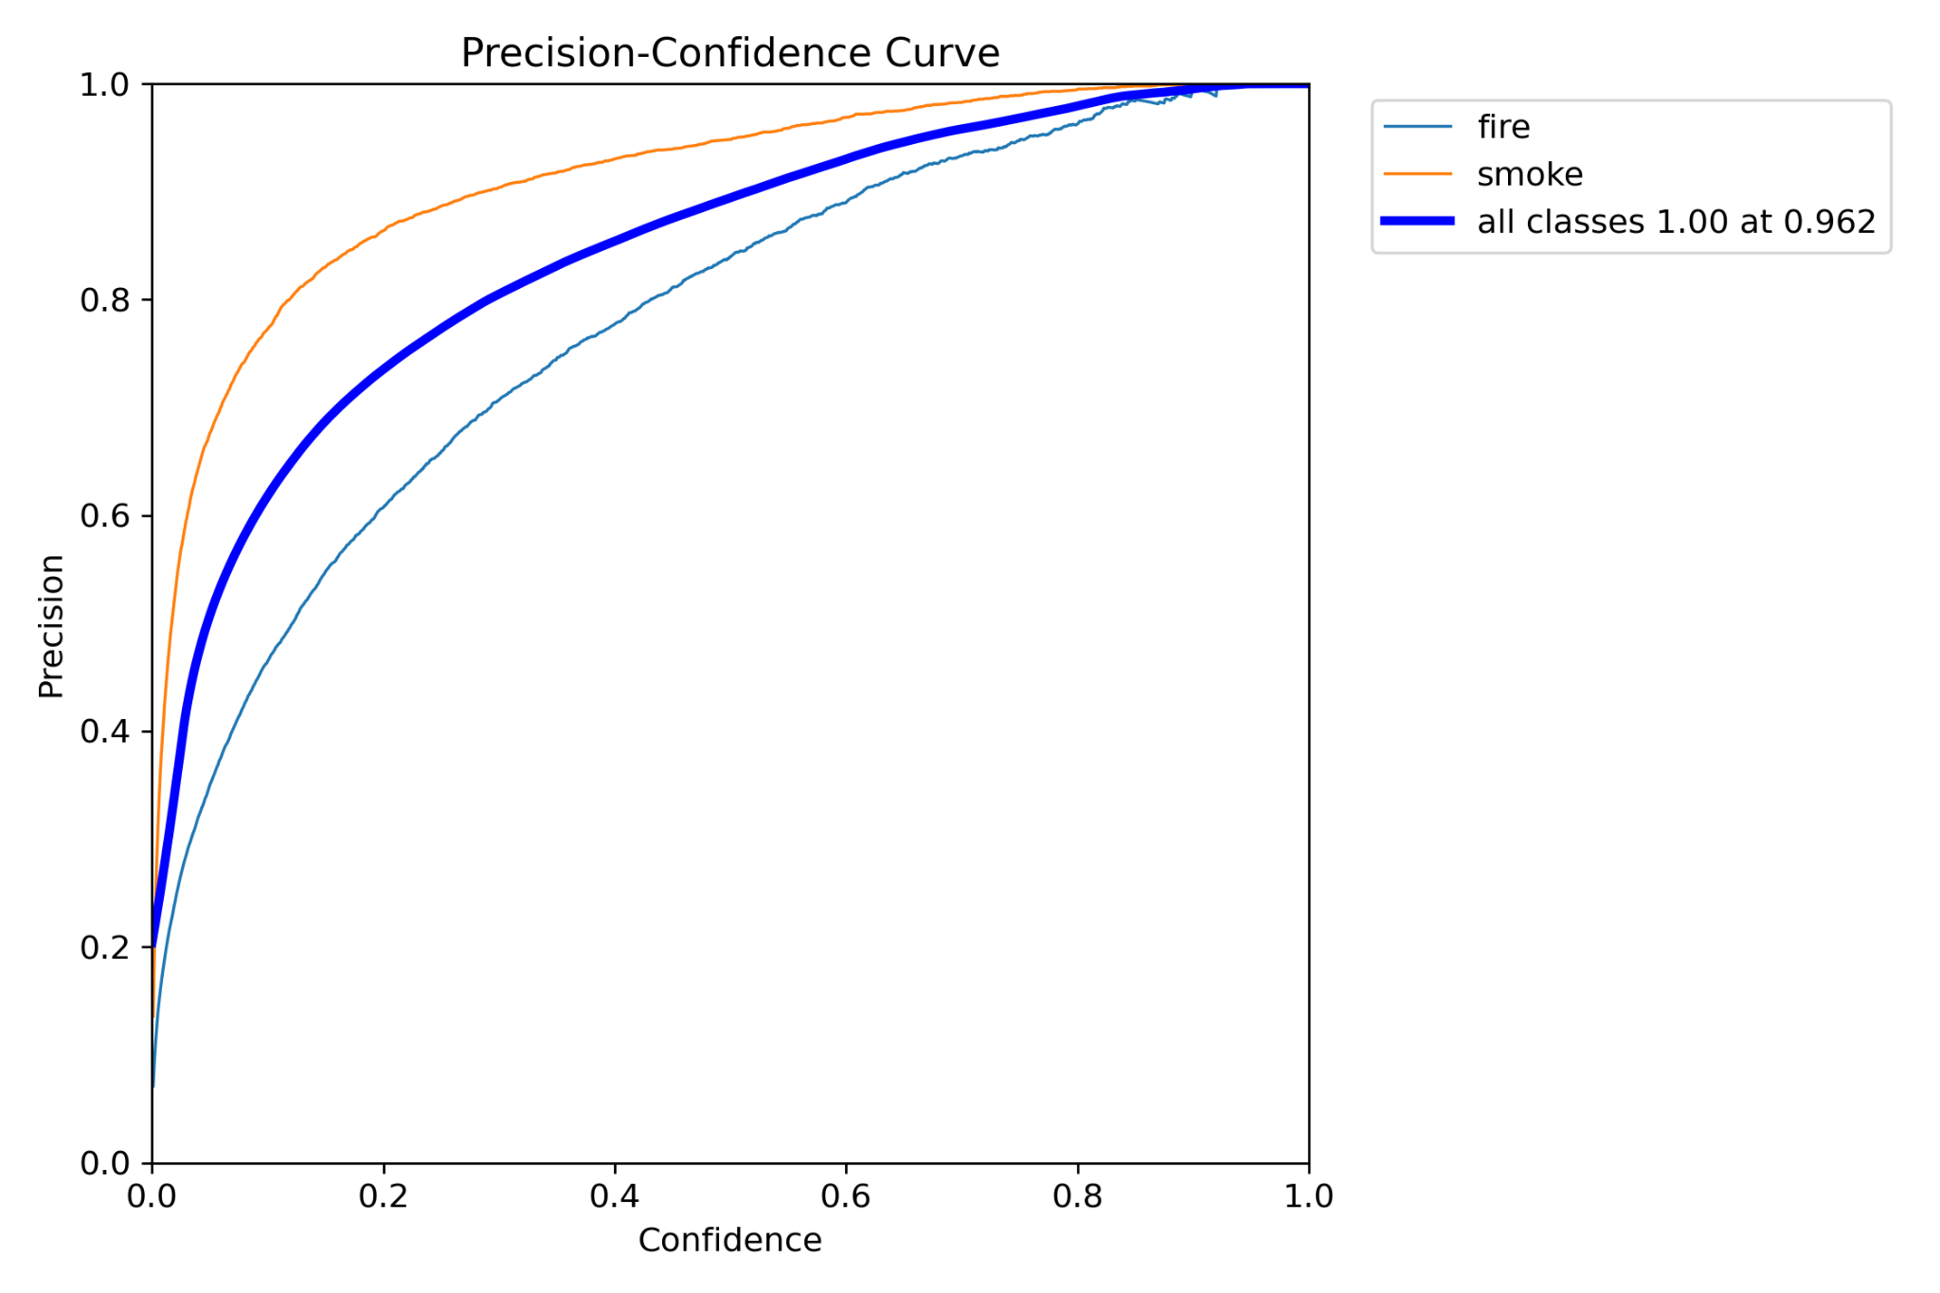
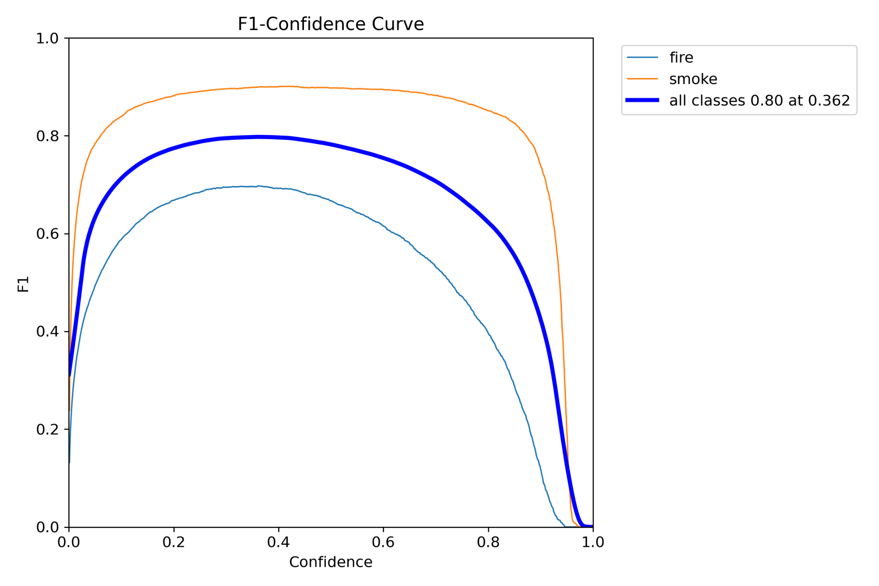
Evaluation Outcomes
Section
Section
12
Model achieved strong object detection performance on the validation set after 50 epochs, demonstrating high precision for real-time application.
Overall Mean Average Precision (mAP):
mAP@0.5: 0.639 (63.9%)
mAP@0.5:0.95: 0.365 (36.5%)
Global Metrics (Optimal Confidence Threshold):
Precision (P): 0.734
Recall (R): 0.579
Optimal F1Score: The peak F1score for all classes reached 0.80 at a confidence threshold of 0.362
Real-Time Performance
Inference Speed: 0.6 ms per 256 times 256 images.
Efficiency: This translates to 1666 FPS, confirming the model is capable of ultra-low latency, real-time fire and smoke detection on standard GPU hardware.

Slide 13
Conclusion
Section
Section
12
YOLOv8 can effectively detect fire with strong accuracy and real-time performance.
Performance depends heavily on dataset quality and diversity.
Some challenges remain, such as false positives and detecting very small or early-stage fires.
Overall, YOLOv8 is a promising approach for practical fire detection systems, especially when combined with improved data and further optimization

Slide 14
Thank You For Listening !
Section
Section
12

